Slide 1
Mathematical foundations of robot motion
Jean-Paul Laumond
ENS-CNRS-INRIA

Slide 2
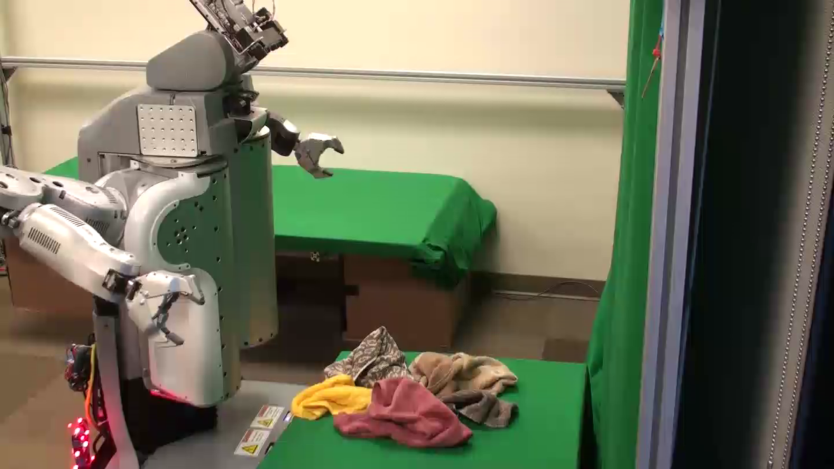
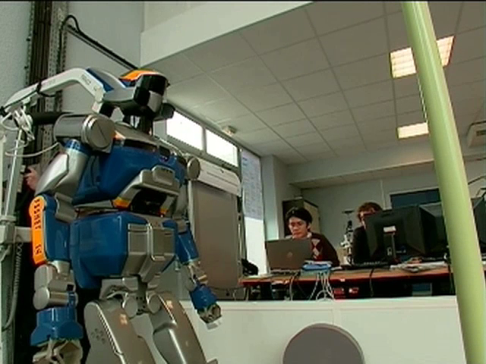
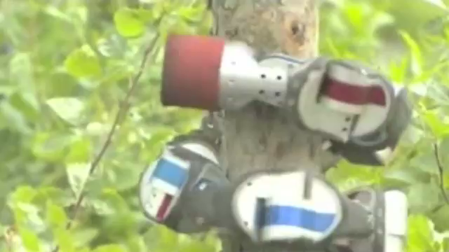
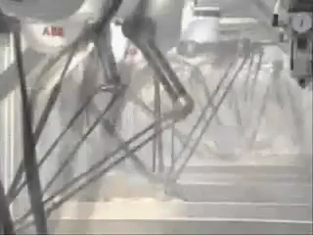
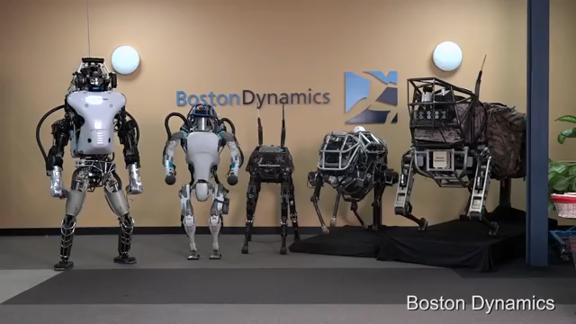
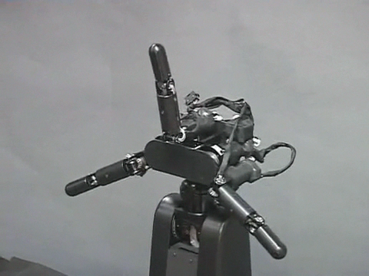
Robotics…
… is about moving computer-controlled machines
Robot PR2, Prof. Abbeel, UC-Berkeley
Climbing Robot, Prof. Choset, CMU
Humanoid Robot HRP2, LAAS-CNRS
Parallel Robot, ABB
Atlas, Boston Dynamics
Prof. Ishikawa, Tokyo University

Slide 3
Robotics is about motion:
How can a machine decide what motion to perform a given task?

Slide 4
40 years of motion planning
A sea of faces
Notes:
So we have seen that the obstacle can be transferred in the configuration. The motion is also well defined is configuration space.
If we look of the motion of this animation. It is set of positions of the system. They corresponds to a continuous curve in the configuration space, on the surface of the tore.

Slide 5
























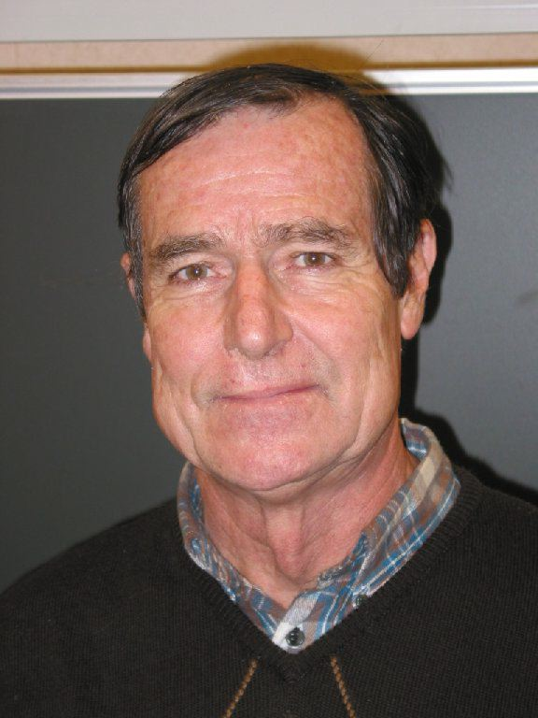
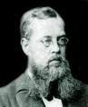
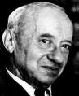
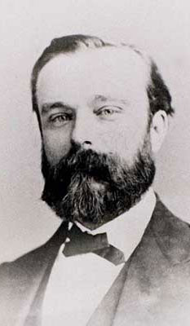













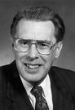






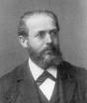



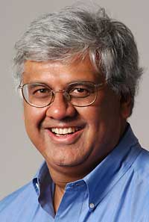






A s e a o f f a c e s

Slide 6
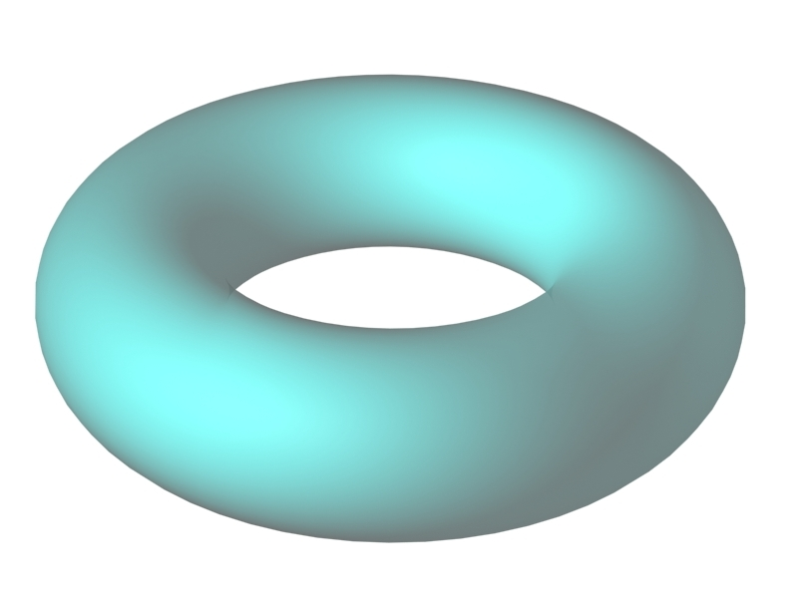
R o b o t M o t i o n P l a n n i n g
Motion : a continuous function from time to space

Slide 7
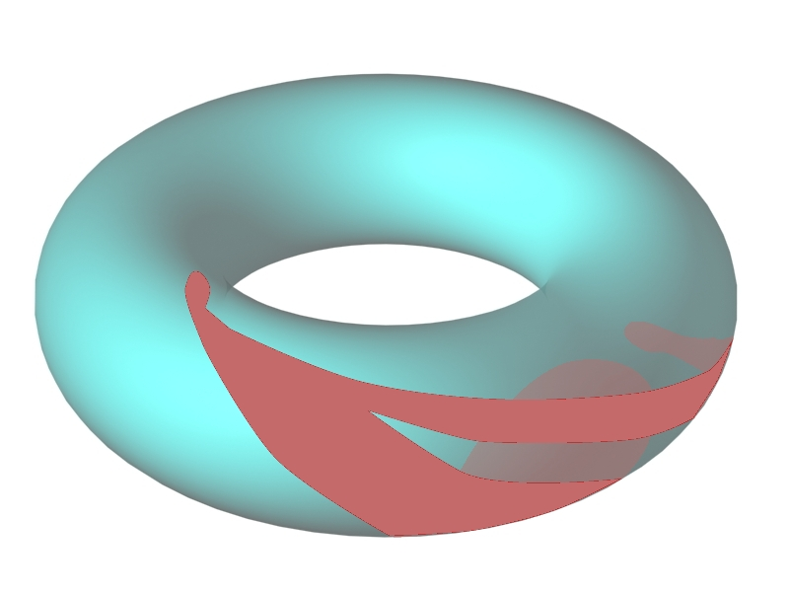
R o b o t M o t i o n P l a n n i n g
Motion : a continuous function from time to space

Slide 8
C o n f i g u r a t i o n S p a c e
Any admissible motion for the 3D mechanical system appears a collision-free path for a point in the CSpace
Notes:
So we have seen that the obstacle can be transferred in the configuration. The motion is also well defined is configuration space.
If we look of the motion of this animation. It is set of positions of the system. They corresponds to a continuous curve in the configuration space, on the surface of the tore.

Slide 9
A l g o r i t h m i c P a t h P l a n n i n g
Translating the continuous problem into a combinatorial one
Capturing the topology of CSfree with graphs
Notes:
So we have seen that the obstacle can be transferred in the configuration. The motion is also well defined is configuration space.
If we look of the motion of this animation. It is set of positions of the system. They corresponds to a continuous curve in the configuration space, on the surface of the tore.

Slide 10
A l g o r i t h m i c P a t h P l a n n i n g
The 80’s
The « piano mover » problem is decidable
Proof: Elementary algebra decidability
Notes:
So we have seen that the obstacle can be transferred in the configuration. The motion is also well defined is configuration space.
If we look of the motion of this animation. It is set of positions of the system. They corresponds to a continuous curve in the configuration space, on the surface of the tore.

Slide 11
A l g o r i t h m i c P a t h P l a n n i n g
The 80’s
The « piano mover » problem is decidable
Doubly exponential constructive proof:
Cylindrical algebraic decomposition
Notes:
So we have seen that the obstacle can be transferred in the configuration. The motion is also well defined is configuration space.
If we look of the motion of this animation. It is set of positions of the system. They corresponds to a continuous curve in the configuration space, on the surface of the tore.

Slide 12
A l g o r i t h m i c P a t h P l a n n i n g
The 80’s
The « piano mover » problem is decidable
Single exponential constructive proof:
Retraction
Notes:
So we have seen that the obstacle can be transferred in the configuration. The motion is also well defined is configuration space.
If we look of the motion of this animation. It is set of positions of the system. They corresponds to a continuous curve in the configuration space, on the surface of the tore.

Slide 13
A l g o r i t h m i c P a t h P l a n n i n g
The 80’s
The « piano mover » problem is decidable
NP-hardness
Notes:
So we have seen that the obstacle can be transferred in the configuration. The motion is also well defined is configuration space.
If we look of the motion of this animation. It is set of positions of the system. They corresponds to a continuous curve in the configuration space, on the surface of the tore.

Slide 14
A l g o r i t h m i c P a t h P l a n n i n g
The 80’s
Existence of motion in contact
Proof: Algebraic topology
Notes:
So we have seen that the obstacle can be transferred in the configuration. The motion is also well defined is configuration space.
If we look of the motion of this animation. It is set of positions of the system. They corresponds to a continuous curve in the configuration space, on the surface of the tore.

Slide 15
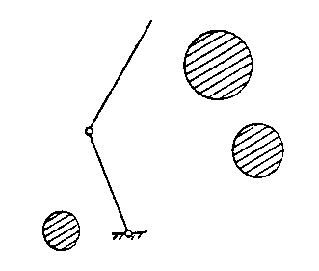
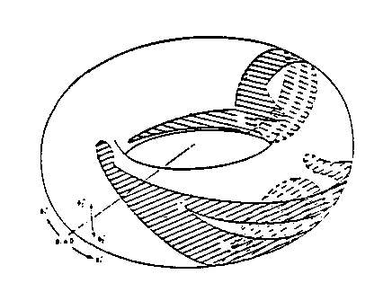
A l g o r i t h m i c P a t h P l a n n i n g
The 80’s
Existence of motion in contact
Proof: Algebraic topology
Notes:
So we have seen that the obstacle can be transferred in the configuration. The motion is also well defined is configuration space.
If we look of the motion of this animation. It is set of positions of the system. They corresponds to a continuous curve in the configuration space, on the surface of the tore.

Slide 16
A l g o r i t h m i c P a t h P l a n n i n g
The 80’s
Existence of motion in contact
Proof: Algebraic topology
Notes:
So we have seen that the obstacle can be transferred in the configuration. The motion is also well defined is configuration space.
If we look of the motion of this animation. It is set of positions of the system. They corresponds to a continuous curve in the configuration space, on the surface of the tore.

Slide 17
A l g o r i t h m i c P a t h P l a n n i n g
The 80’s
Existence of motion in contact
Proof: Algebraic topology
Notes:
So we have seen that the obstacle can be transferred in the configuration. The motion is also well defined is configuration space.
If we look of the motion of this animation. It is set of positions of the system. They corresponds to a continuous curve in the configuration space, on the surface of the tore.

Slide 18
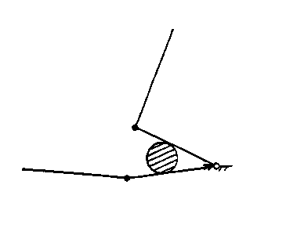
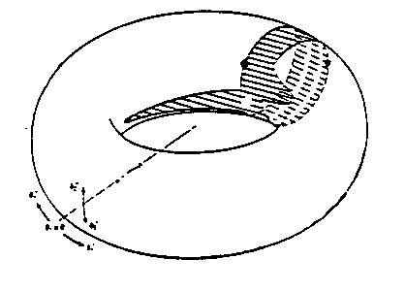
A l g o r i t h m i c P a t h P l a n n i n g
The 80’s
Existence of motion in contact
Proof: Algebraic topology
Notes:
So we have seen that the obstacle can be transferred in the configuration. The motion is also well defined is configuration space.
If we look of the motion of this animation. It is set of positions of the system. They corresponds to a continuous curve in the configuration space, on the surface of the tore.

Slide 19
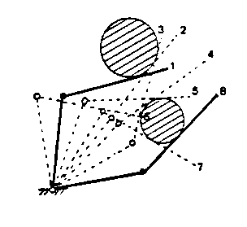
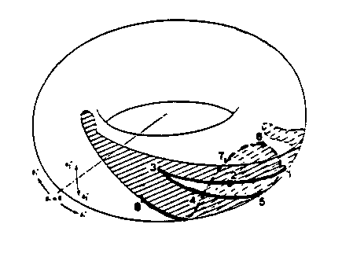
A l g o r i t h m i c P a t h P l a n n i n g
The 80’s
Existence of motion in contact
Proof: Algebraic topology
Notes:
So we have seen that the obstacle can be transferred in the configuration. The motion is also well defined is configuration space.
If we look of the motion of this animation. It is set of positions of the system. They corresponds to a continuous curve in the configuration space, on the surface of the tore.

Slide 20
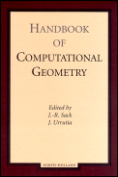
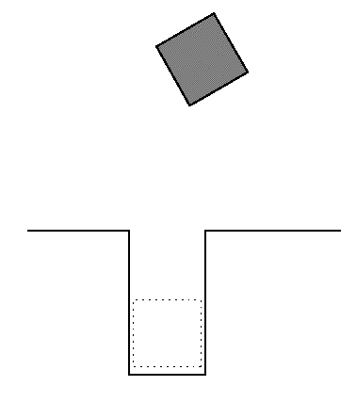
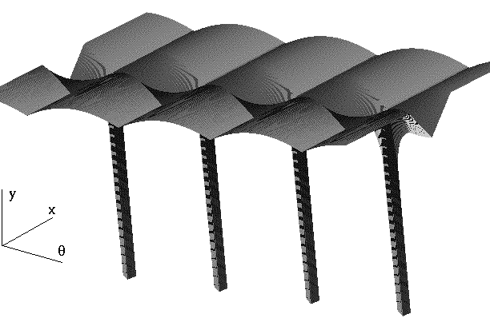
A l g o r i t h m i c P a t h P l a n n i n g
The 80’s
Special cases and computational geometry
Notes:
So we have seen that the obstacle can be transferred in the configuration. The motion is also well defined is configuration space.
If we look of the motion of this animation. It is set of positions of the system. They corresponds to a continuous curve in the configuration space, on the surface of the tore.

Slide 21
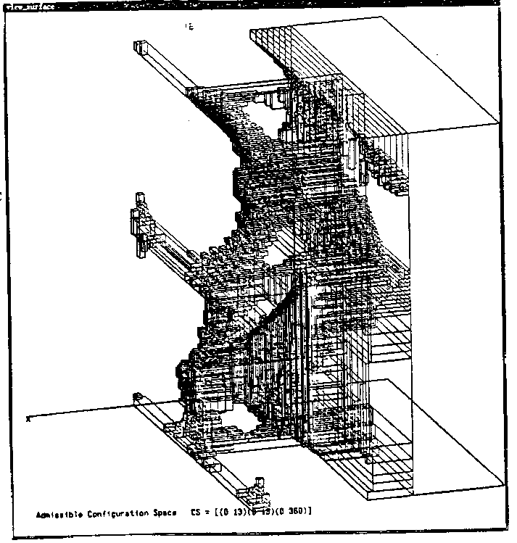

A l g o r i t h m i c P a t h P l a n n i n g
The 80’s: and then?
No hope for efficient exact and complete solution
Approximated solution
Notes:
So we have seen that the obstacle can be transferred in the configuration. The motion is also well defined is configuration space.
If we look of the motion of this animation. It is set of positions of the system. They corresponds to a continuous curve in the configuration space, on the surface of the tore.

Slide 22
A l g o r i t h m i c P a t h P l a n n i n g
The 80’s: and then?
No hope for efficient exact and complete solution
Potential fields and optimization methods
Notes:
So we have seen that the obstacle can be transferred in the configuration. The motion is also well defined is configuration space.
If we look of the motion of this animation. It is set of positions of the system. They corresponds to a continuous curve in the configuration space, on the surface of the tore.

Slide 23
When hardware renewed the topic…
Notes:
So we have seen that the obstacle can be transferred in the configuration. The motion is also well defined is configuration space.
If we look of the motion of this animation. It is set of positions of the system. They corresponds to a continuous curve in the configuration space, on the surface of the tore.

Slide 24
R a n d o m S e a r c h e s
The 90’s: the amazing efficiency of empirism!
Notes:
So we have seen that the obstacle can be transferred in the configuration. The motion is also well defined is configuration space.
If we look of the motion of this animation. It is set of positions of the system. They corresponds to a continuous curve in the configuration space, on the surface of the tore.

Slide 25
R a n d o m S e a r c h e s
The 90’s: the amazing efficiency of empirism!
Random sampling
Notes:
So we have seen that the obstacle can be transferred in the configuration. The motion is also well defined is configuration space.
If we look of the motion of this animation. It is set of positions of the system. They corresponds to a continuous curve in the configuration space, on the surface of the tore.

Slide 26
R a n d o m S e a r c h e s
The 90’s: the amazing efficiency of empirism!
Random diffusion
Notes:
So we have seen that the obstacle can be transferred in the configuration. The motion is also well defined is configuration space.
If we look of the motion of this animation. It is set of positions of the system. They corresponds to a continuous curve in the configuration space, on the surface of the tore.

Slide 27
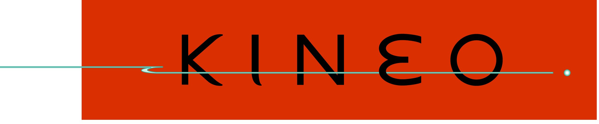
R a n d o m S e a r c h e s
The 90’s: the amazing efficiency of empirism!
Notes:
So we have seen that the obstacle can be transferred in the configuration. The motion is also well defined is configuration space.
If we look of the motion of this animation. It is set of positions of the system. They corresponds to a continuous curve in the configuration space, on the surface of the tore.

Slide 28
R o b o t M o t i o n P l a n n i n g
…and that works!

Slide 29
R o b o t M o t i o n P l a n n i n g
Pause

Slide 30
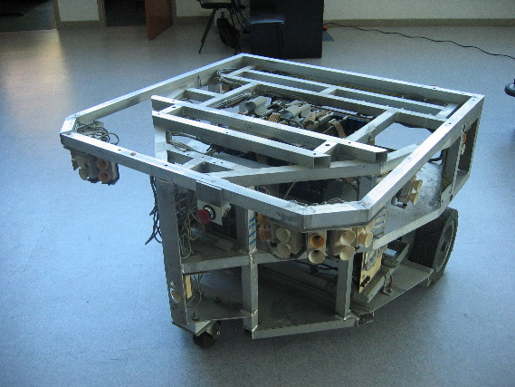
N o n h o l o n o m i c s y s t e m s
Notes:
So we have seen that the obstacle can be transferred in the configuration. The motion is also well defined is configuration space.
If we look of the motion of this animation. It is set of positions of the system. They corresponds to a continuous curve in the configuration space, on the surface of the tore.

Slide 31
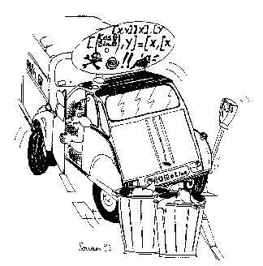
N o n h o l o n o m i c s y s t e m s
The 90’s: rolling without sliding!
Notes:
So we have seen that the obstacle can be transferred in the configuration. The motion is also well defined is configuration space.
If we look of the motion of this animation. It is set of positions of the system. They corresponds to a continuous curve in the configuration space, on the surface of the tore.

Slide 32
N o n h o l o n o m i c s y s t e m s
The 90’s
Any admissible motion for the 3D mechanical system appears a collision-free path for a point in the Cspace
Holonomic systems: converse is true
Nonholonomic ones: converse is not true
Notes:
So we have seen that the obstacle can be transferred in the configuration. The motion is also well defined is configuration space.
If we look of the motion of this animation. It is set of positions of the system. They corresponds to a continuous curve in the configuration space, on the surface of the tore.

Slide 33
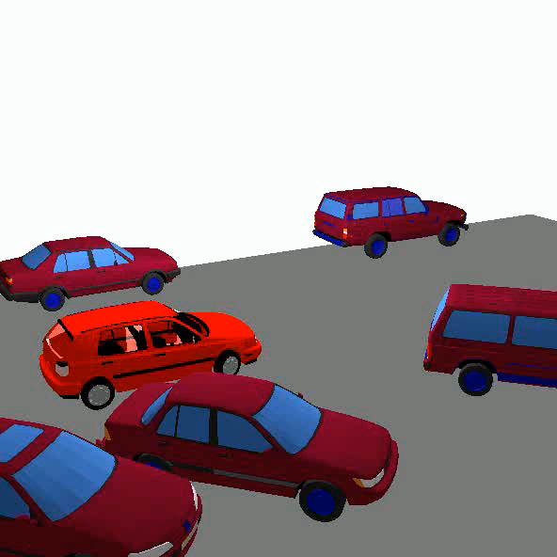
N o n h o l o n o m i c s y s t e m s
The 90’s: the car-like robot
The number of maneuvers varies as the inverse of the square of the size of the free-space
Notes:
So we have seen that the obstacle can be transferred in the configuration. The motion is also well defined is configuration space.
If we look of the motion of this animation. It is set of positions of the system. They corresponds to a continuous curve in the configuration space, on the surface of the tore.

Slide 34

N o n h o l o n o m i c s y s t e m s
Holonomy versus nonholonomy: an integrability question
Notes:
So we have seen that the obstacle can be transferred in the configuration. The motion is also well defined is configuration space.
If we look of the motion of this animation. It is set of positions of the system. They corresponds to a continuous curve in the configuration space, on the surface of the tore.

Slide 35
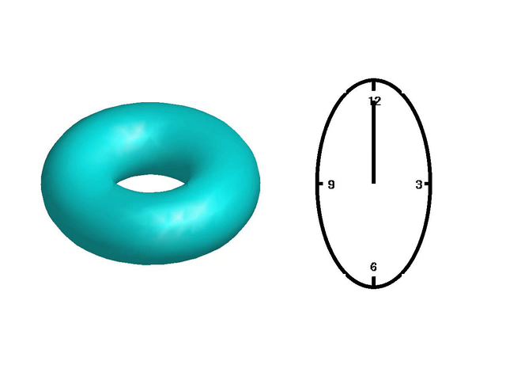
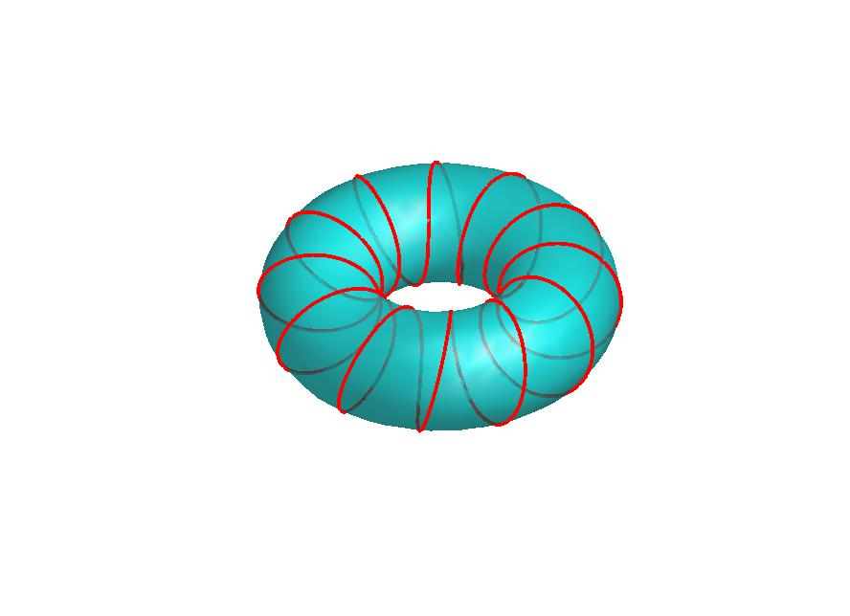
N o n h o l o n o m i c s y s t e m s
Holonomy versus nonholonomy: an integrability question
Not integrable
Dim(Reachable(q))=3
The time that will
never happen!!!
Notes:
So we have seen that the obstacle can be transferred in the configuration. The motion is also well defined is configuration space.
If we look of the motion of this animation. It is set of positions of the system. They corresponds to a continuous curve in the configuration space, on the surface of the tore.

Slide 36
N o n h o l o n o m i c s y s t e m s
Small-time controllability
Notes:
So we have seen that the obstacle can be transferred in the configuration. The motion is also well defined is configuration space.
If we look of the motion of this animation. It is set of positions of the system. They corresponds to a continuous curve in the configuration space, on the surface of the tore.

Slide 37
N o n h o l o n o m i c s y s t e m s
Small-time controllability
Notes:
So we have seen that the obstacle can be transferred in the configuration. The motion is also well defined is configuration space.
If we look of the motion of this animation. It is set of positions of the system. They corresponds to a continuous curve in the configuration space, on the surface of the tore.

Slide 38
N o n h o l o n o m i c s y s t e m s
Small-time controllability
Notes:
So we have seen that the obstacle can be transferred in the configuration. The motion is also well defined is configuration space.
If we look of the motion of this animation. It is set of positions of the system. They corresponds to a continuous curve in the configuration space, on the surface of the tore.

Slide 39
N o n h o l o n o m i c s y s t e m s
Small-time controllability
Notes:
So we have seen that the obstacle can be transferred in the configuration. The motion is also well defined is configuration space.
If we look of the motion of this animation. It is set of positions of the system. They corresponds to a continuous curve in the configuration space, on the surface of the tore.

Slide 40
N o n h o l o n o m i c s y s t e m s
Small-time controllability
For small-time controllable systems the existence of an admissible motion is characterized by the existence of a path lying in an open connected component of free-CSpace
Notes:
So we have seen that the obstacle can be transferred in the configuration. The motion is also well defined is configuration space.
If we look of the motion of this animation. It is set of positions of the system. They corresponds to a continuous curve in the configuration space, on the surface of the tore.

Slide 41
N o n h o l o n o m i c s y s t e m s
Two central questions
Is my system nonholonomic ?
Is my nonholonomic system small-time controllable ?
Notes:
So we have seen that the obstacle can be transferred in the configuration. The motion is also well defined is configuration space.
If we look of the motion of this animation. It is set of positions of the system. They corresponds to a continuous curve in the configuration space, on the surface of the tore.

Slide 42
N o n h o l o n o m i c s y s t e m s
Two central questions
Is my system nonholonomic ?
Frobenius Theorem
Is my nonholonomic system small-time controllable ?
Lie Algebra Rank Condition
Notes:
So we have seen that the obstacle can be transferred in the configuration. The motion is also well defined is configuration space.
If we look of the motion of this animation. It is set of positions of the system. They corresponds to a continuous curve in the configuration space, on the surface of the tore.

Slide 43
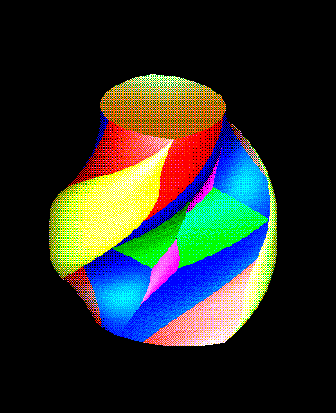
N o n h o l o n o m i c s y s t e m s
Devising steering methods that account for small-time controllability
Optimal control
Notes:
So we have seen that the obstacle can be transferred in the configuration. The motion is also well defined is configuration space.
If we look of the motion of this animation. It is set of positions of the system. They corresponds to a continuous curve in the configuration space, on the surface of the tore.

Slide 44
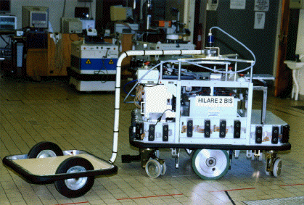
N o n h o l o n o m i c s y s t e m s
Devising steering methods that account for small-time controllability
Optimal control: numerical approach
Notes:
So we have seen that the obstacle can be transferred in the configuration. The motion is also well defined is configuration space.
If we look of the motion of this animation. It is set of positions of the system. They corresponds to a continuous curve in the configuration space, on the surface of the tore.

Slide 45
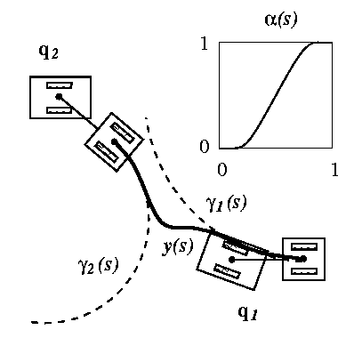
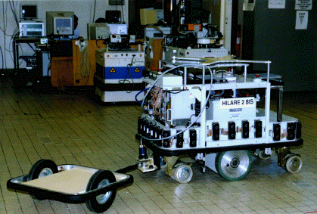
N o n h o l o n o m i c s y s t e m s
Devising steering methods that account for small-time controllability
Chained-from systems
Flatness
Notes:
So we have seen that the obstacle can be transferred in the configuration. The motion is also well defined is configuration space.
If we look of the motion of this animation. It is set of positions of the system. They corresponds to a continuous curve in the configuration space, on the surface of the tore.

Slide 46
N o n h o l o n o m i c s y s t e m s
Nonholonomic metrics as a model of computational complexity
Notes:
So we have seen that the obstacle can be transferred in the configuration. The motion is also well defined is configuration space.
If we look of the motion of this animation. It is set of positions of the system. They corresponds to a continuous curve in the configuration space, on the surface of the tore.

Slide 47
N o n h o l o n o m i c s y s t e m s
Remaining open problems
clothoids
involutes of a circle
Time-optimal control
Notes:
So we have seen that the obstacle can be transferred in the configuration. The motion is also well defined is configuration space.
If we look of the motion of this animation. It is set of positions of the system. They corresponds to a continuous curve in the configuration space, on the surface of the tore.

Slide 48
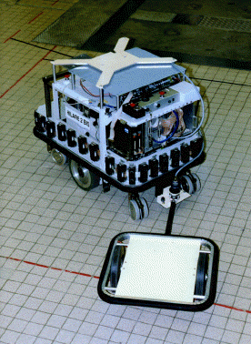
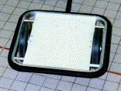
N o n h o l o n o m i c s y s t e m s
Remaining open problems
Hooking
centered
not
2
2
3
3
4
5
5
(2,3,4,5) versus (2,3,5)
Notes:
So we have seen that the obstacle can be transferred in the configuration. The motion is also well defined is configuration space.
If we look of the motion of this animation. It is set of positions of the system. They corresponds to a continuous curve in the configuration space, on the surface of the tore.

Slide 49
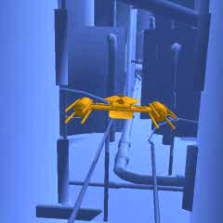
N o n h o l o n o m i c s y s t e m s
Remaining open problems
Not small-time controllable systems:
is the problem still decidable?
Notes:
So we have seen that the obstacle can be transferred in the configuration. The motion is also well defined is configuration space.
If we look of the motion of this animation. It is set of positions of the system. They corresponds to a continuous curve in the configuration space, on the surface of the tore.

Slide 50
R o b o t M o t i o n P l a n n i n g
…and that works!

Slide 51
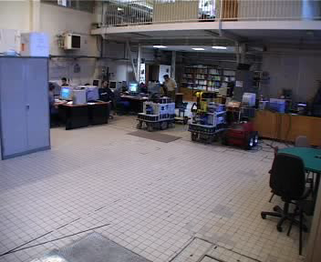
R o b o t M o t i o n P l a n n i n g
Robot motion autonomy

Slide 52
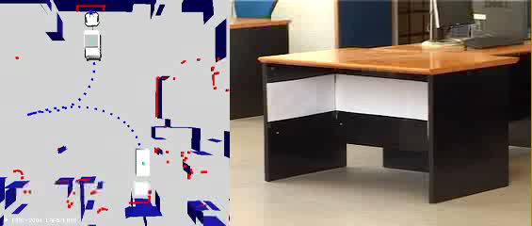
R o b o t M o t i o n P l a n n i n g
Robot motion autonomy

Slide 53
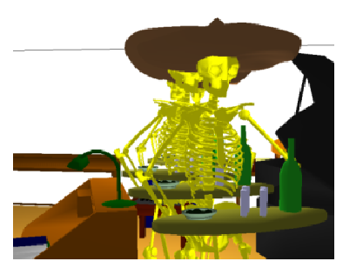
B e y o n d R o b o t i c s
Computer animation

Slide 54
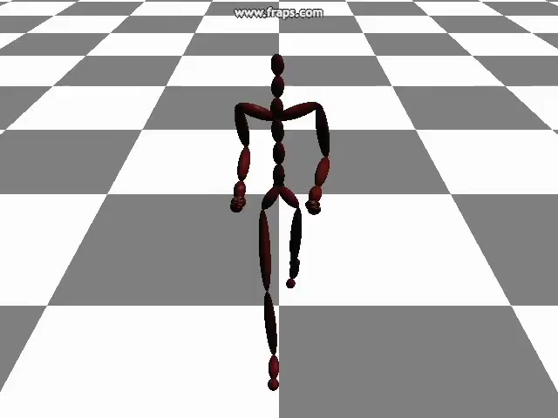
B e y o n d R o b o t i c s
Computer animation

Slide 55
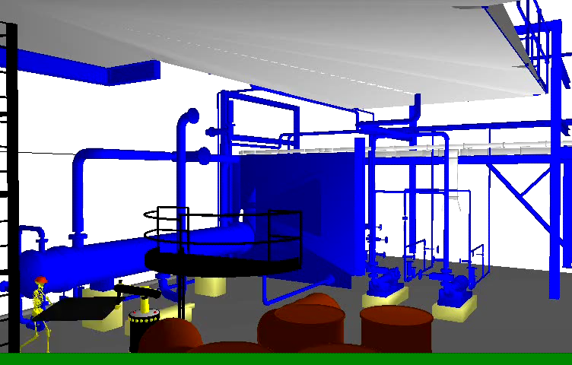
B e y o n d R o b o t i c s
Computer animation

Slide 56
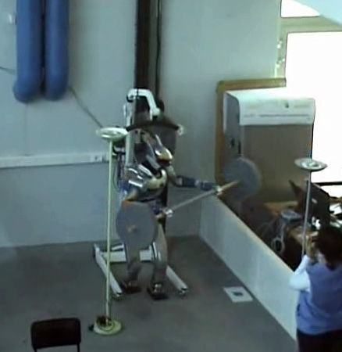
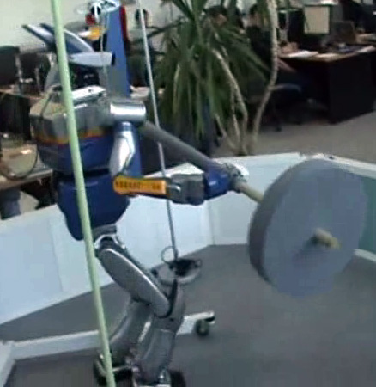
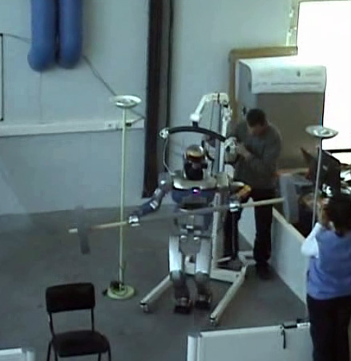
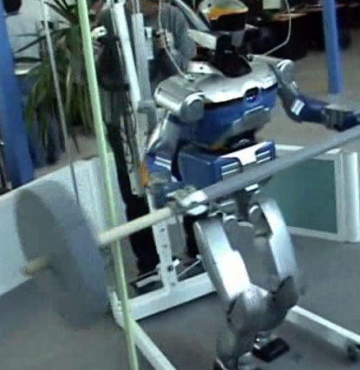
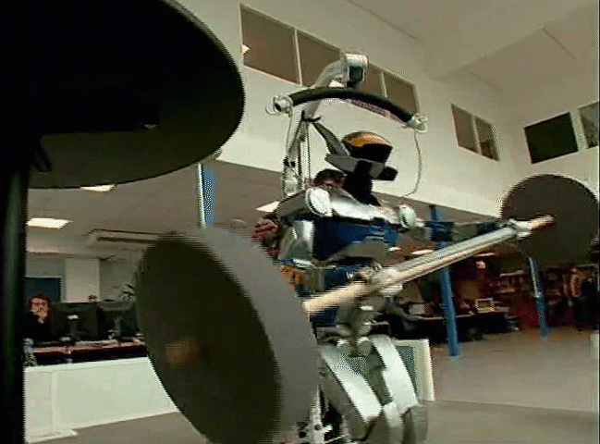
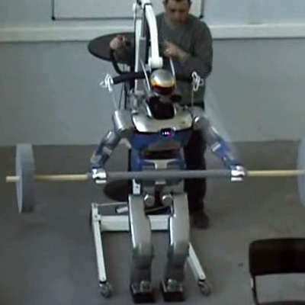

R o b o t i c s
Humanoid robots

Slide 57
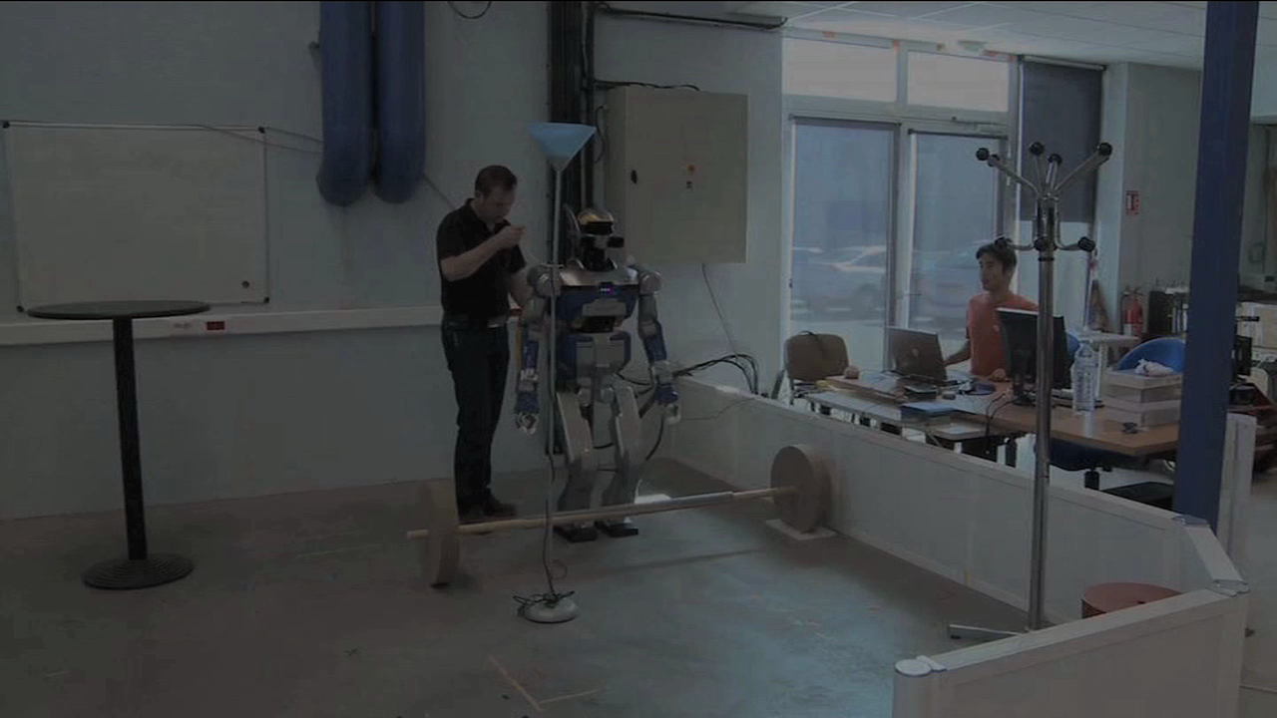
R o b o t i c s
Humanoid robots

Slide 58


R o b o t i c s
Humanoid robots

Slide 59



R o b o t i c s
Humanoid robots

Slide 60




B e y o n d R o b o t i c s
Computer animation

Slide 61

B e y o n d R o b o t i c s
Computer animation

Slide 62

R o b o t M o t i o n P l a n n i n g
Robot programming

Slide 63




















B e y o n d R o b o t i c s
Product Lifecycle Management
Automotive industry

Slide 64

B e y o n d R o b o t i c s
Molecular modeling

Slide 65




B e y o n d R o b o t i c s
A380 component transportation by road
They were right !!...

Slide 66

B e y o n d R o b o t i c s
Life Sciences

Slide 67






B e y o n d R o b o t i c s
Life Sciences

Slide 68


B e y o n d R o b o t i c s
Life Sciences

Slide 69
R o b o t M o t i o n P l a n n i n g
As a conclusion…
« Doing while understanding »

Slide 71




Bibliography

